Slide 1



ACROSS CULTURES 4:
Education in Great Britain and the USA
Part 1

Slide 2
compulsory
boarding school
obavezan
BRAINSTORMING
internat
secondary school
extracurricular
srednja škola
EDUCATION
izvannastavne aktivnosti
catchment area
assembly
okupljanje, skup
okrug, okolno područje
gown
grammar school
svečana haljina
gimnazija
elective subject
izborni predmeti

Slide 3
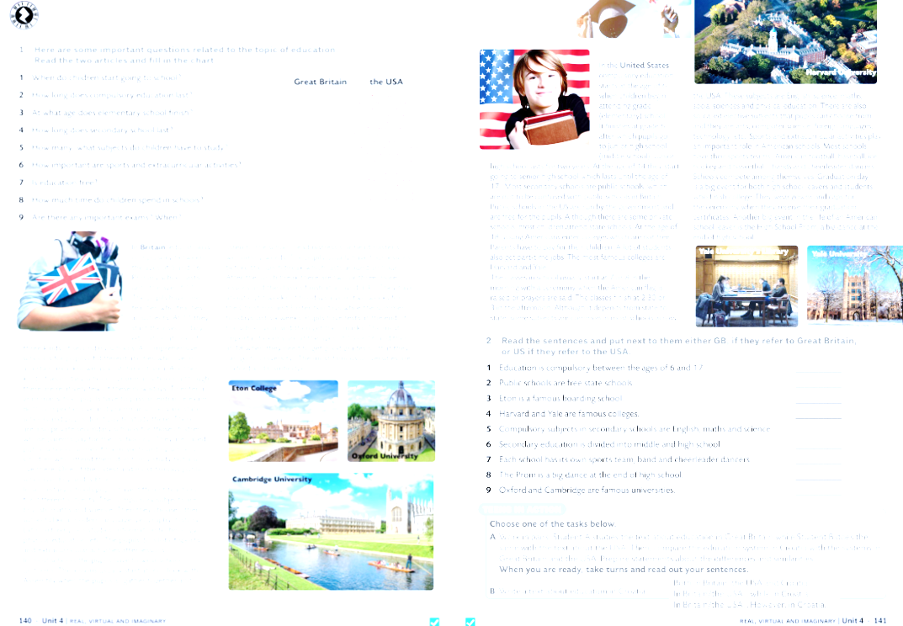


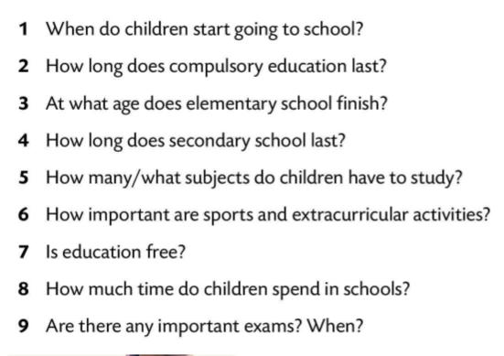

Slide 4
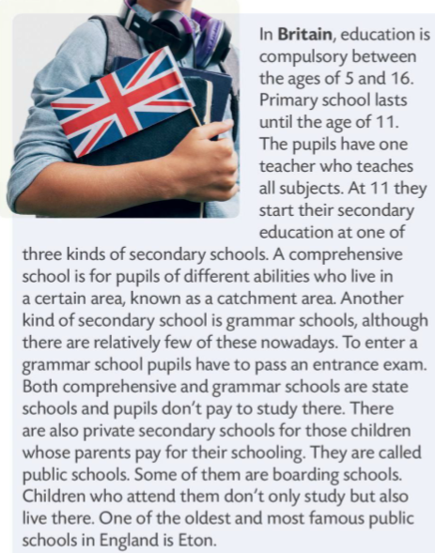
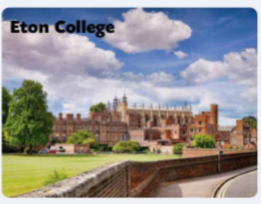
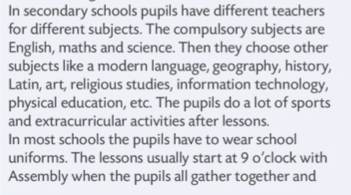

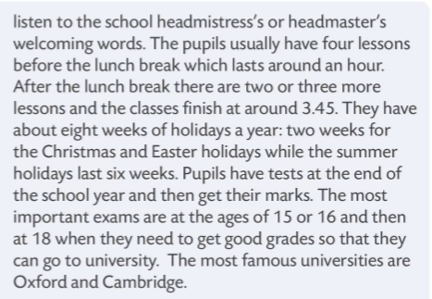


Slide 5
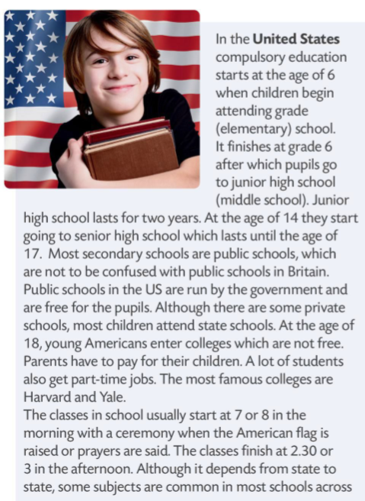
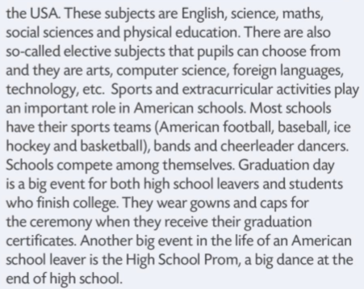




Slide 6
